Slide 1
Introduction To NMAP and Network Scanning

Slide 2
Network Foot Print and Scanning
Mapping the Remote Network
OS Foot printing
Remote Network Scanning

Slide 3

NMAP
We will use two versions
GUI and Command Line
For the Command Line
Backtrack
GUI
Zenmap

Slide 4
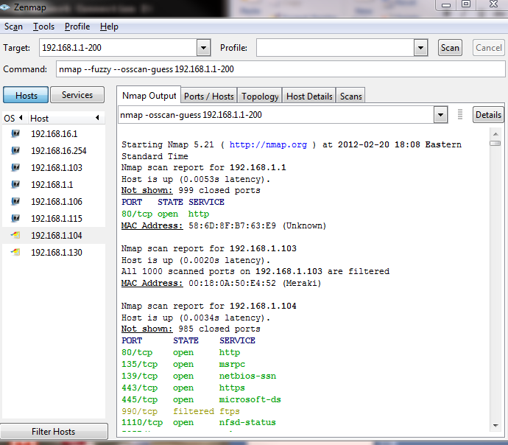
Sample Versions- ZENMAP

Slide 5
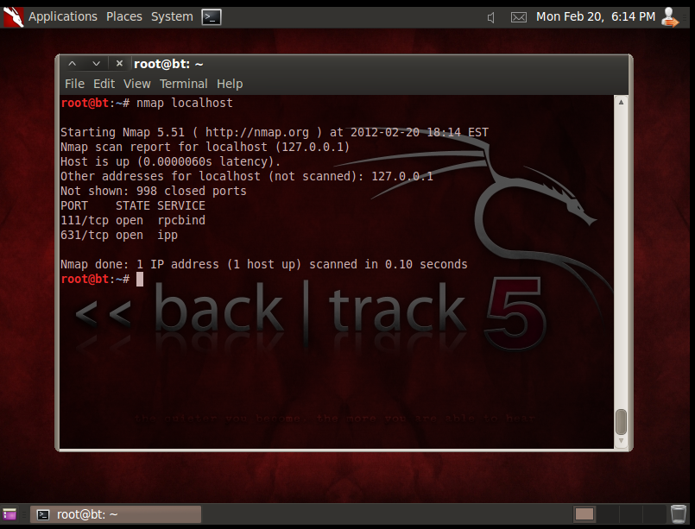
Command Line

Slide 6
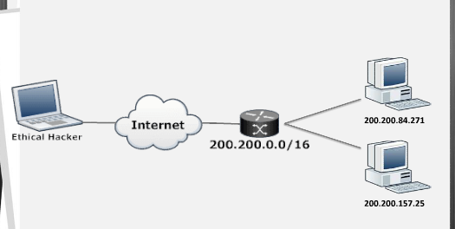
Mapping the Remote Network
Determine the Live Hosts
A ping Sweep will allow you to determine which IP addresses will are alive and available for security inspection or review.

Slide 7
Tools to do a Ping Sweep
nmap –sP [IP Range]
fping –g –a [IP Range]

Slide 8
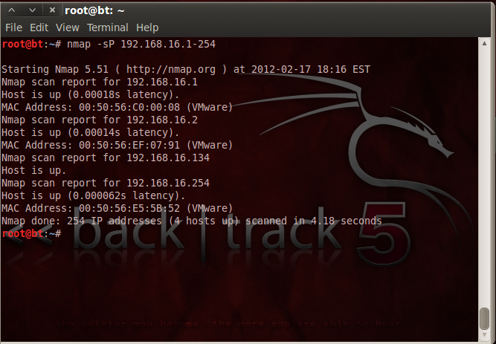
Example nmap

Slide 9
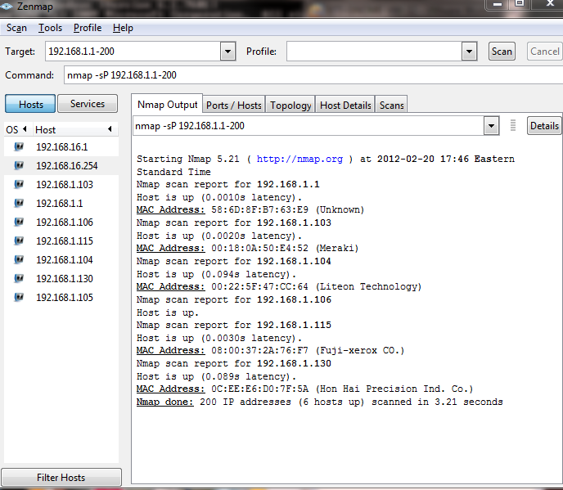
NMAP - ZENMAP

Slide 10
OS Finger Printing
Now that we have a list of IP addresses lets find out which type of software has response to our pings – The operating system.
OS fingerprinting is the technique used to discover the operating system on the remote host.
Processes works like this
Send Requests
Analyze Responses

Slide 11
OS Finger Printing
This most at times guess work and we will not have a 100% secure answer.
But based on experience we can be able to be pretty sure of the final outcome.

Slide 12
Using NMAP
Initiate OS Detection by using this command
nmap -PN –O <ip>

Slide 13
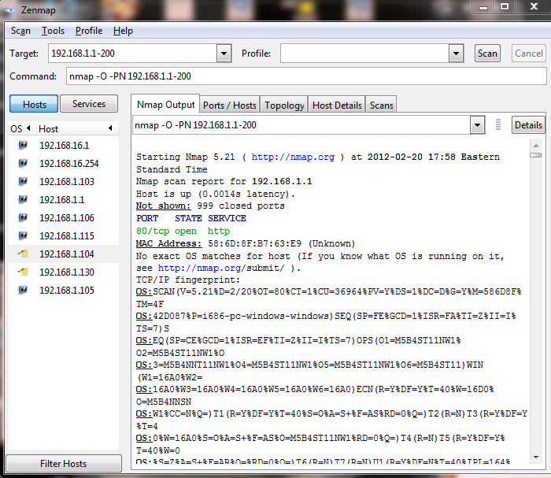
Example

Slide 14
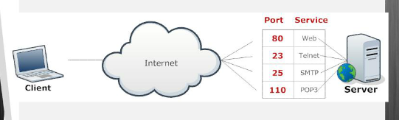
Port Scans
Daemons are software programs running on remote servers which implement a given Service such as telnet that requires a specific port to be open in order to communicate with other services or clients

Slide 15
Why Port Scanning
Port Scanning is the technique used by attackers to map services that are listening on a specific port.
The security tester can use this method to create a list of potential weaknesses and vulnerabilities in daemons running on these open ports leading to exploitation and compromised of a remote host.

Slide 16
Type of Scan
- sS Stealth Scan
-sT Full connect (TCP) scan: three-way handshake
-sV Services Scan
Regardless of the scan type, nmap probes the ports by sending the SYN packet to open the communications with the host and then awaits specific responses to determine the port states.

Slide 17


Stealth Scan
nmap -sS [IP Address]
Establishes only ½ of a TCP/IP Handshake
Dst:192.168.1.110
Port:80
Flag: Syn
Syn/ACK

Slide 18
Full Connect Scan
nmap -sT [IP Address]
Establishes a full TCP/IP Handshake just like the O/S.
Slower and more “nosier” than the Stealth Scan
Dst:192.168.1.110
Port:80
Flag: Syn
SYN/ACK
ACK

Slide 19
Services Scan
nmap -sV [IP Address]
Establishes a full TCP/IP Handshake just like the O/S.
Slower very noisy
Dst:192.168.1.110
Port:80
Flag: Syn
SYN/ACK
ACK
Banner:IIS 7.0

Slide 20
Lets Put it Together
nmap –sS –p1-3000 192.168.1.1
With the above command we tell nmap to scan ports 1 to 3000 on host 192.168.1.1 using the SYN/Stealth scan –sS.
This scan will return the status of the ports on the remote host

Slide 21
Port States
Port States
Open – an application is accepting TCP Connections or UDP packets on this ports. This is the primary goal of the ports scanning
Closed – A closed port is accessible, but there is no application listening on it.
Filtered – nmap is unable to reach the port due to blocking by the firewall.
Unfiltered – the port is accessible but nmap is unable to determine if is open or closed.

Slide 22
Recap
This is just the basics of nmap.
Use as an initial discovery tool.
Hosts
Devices
Operations systems
Wireless Devices
nmap will discover services that are present on a host and network.
Once the services are know you can go to Google and search for potential vulnerabilities.
The scans can be “noisy” or stealthy depending on your objectives
Attack and Pen – Stealthy
Normal discovery noise

